Slide 1
Software Testing and Quality Assurance
Theory and Practice
Chapter 6
Domain Testing
Notes:
Handouts
------------------------------------------------------------------
------------------------------------------------------------------
-------------------------------------------------------------------
--------------------------------------------------------------------

Slide 2
Outline of the Chapter
Domain Error
Testing for Domain Errors
Sources of Domains
Types of Domain Errors
ON and OFF Points
Test Selection Criterion
Summary
Notes:
Handouts

Slide 3
Domain Error
Two fundamental elements of a program
  Input domain: The set of all input data to the program
  Program path: A sequence of instructions from entry to exit
    Feasible path: If there exists input data which causes the path to execute.
    Infeasible path: No input data exists to cause the path to execute.
Howden identified 2 classes of errors by combining input domain and program paths.
  Computation error
  Domain error
Computation error
  A computation error occurs when a specific input data causes the correct path to execute, but the output value is wrong.
Domain error
  A domain error occurs when a specific input data causes the program to execute a wrong (i.e. undesired) path.
Notes:
Handouts

Slide 4
Domain Error
Idea
  An input causes a path to execute.
  Different input data (i.e. a set of inputs) cause the same path to execute.
  Domain: A domain is a set of input values for which the program performs the same computation for every member of the set.
  We are interested in maximal domains such that the program performs different computations in different domains.
Notes:
Handouts

Slide 5
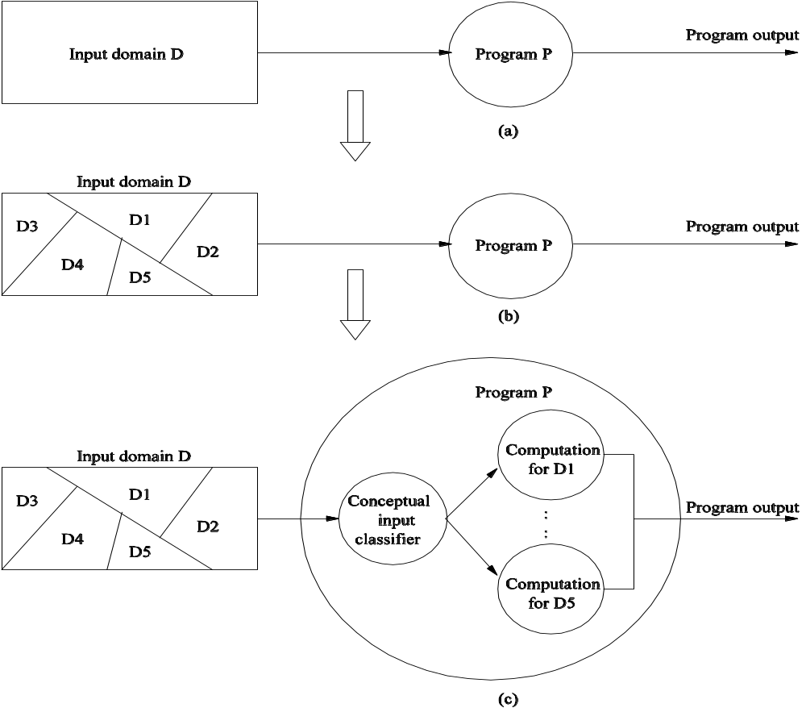
Domain Error
  Figure 6.1: Illustration of the concept of program domains.
Notes:
Handouts

Slide 6
Domain Error
A program is considered as an input classifier.
A program is said to have a domain error if it incorrectly performs input classification.
  Wrong classification: This means a wrong path is executed for a specific input data.
Notes:
Handouts

Slide 7
Testing for Domain Errors
The idea of domain testing was first studied by White and Cohen.
Domain testing differs from control/data flow testing.
Flashback: control/data flow testing
  Note: No assumption is made about any kind of error in the program.
  Draw a graph – control flow or data flow.
  Select paths based on path selection criteria: statement, branch, all-use ...
  Generate input data from the selected paths.
In contrast, in domain testing
  One identifies a category of faults, known as domain errors.
We will discuss the following.
  Sources of domain
  Types of domain errors
  Selecting test data to reveal domain errors
Notes:
Handouts

Slide 8
Sources of Domains
int codedomain(int x, int y){
int c, d, k
c = x + y;
if (c > 5) d = c - x/2;
else d = c + x/2;
if (d >= c + 2) k = x + d/2;
else k = y + d/4;
return(k);
}
Fig. 6.2: A function to explain program domains.
Notes:
Handouts

Slide 9
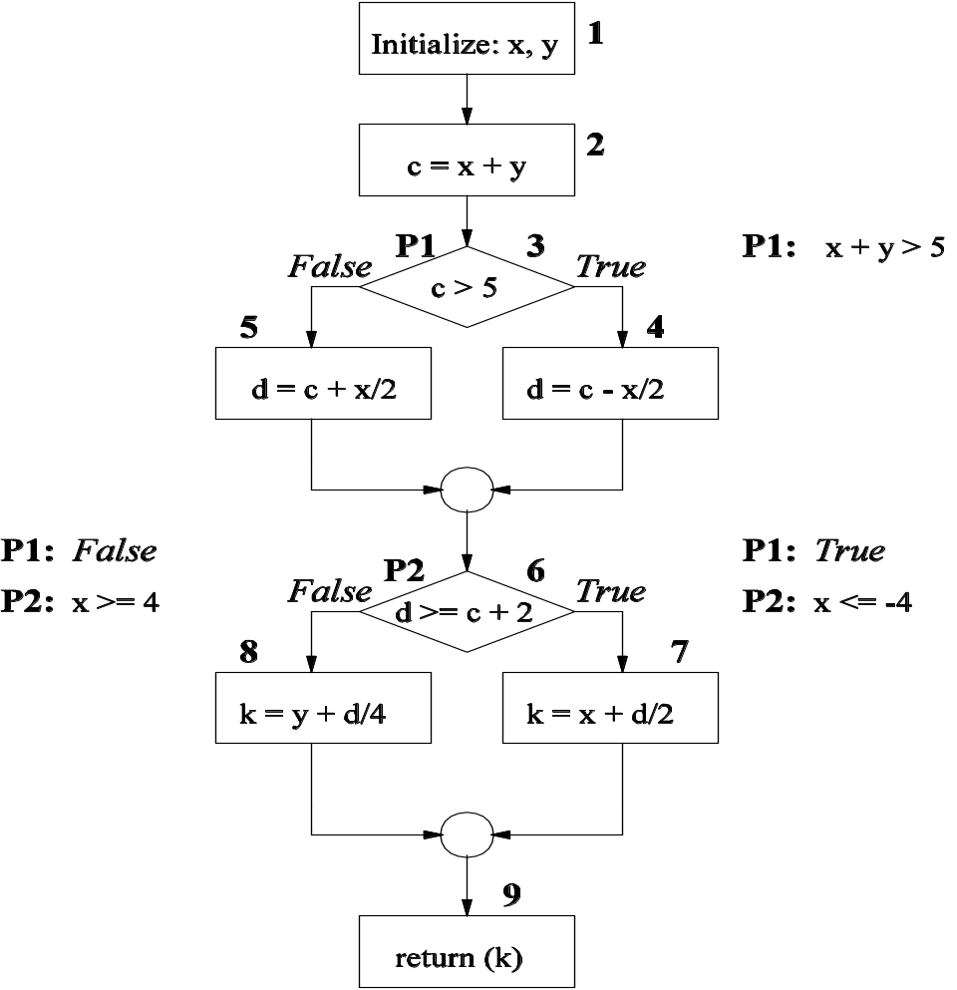
Domain Error
Figure 6.3: Control flow graph rep. of the function in Fig. 6.2.
Notes:
Handouts

Slide 10
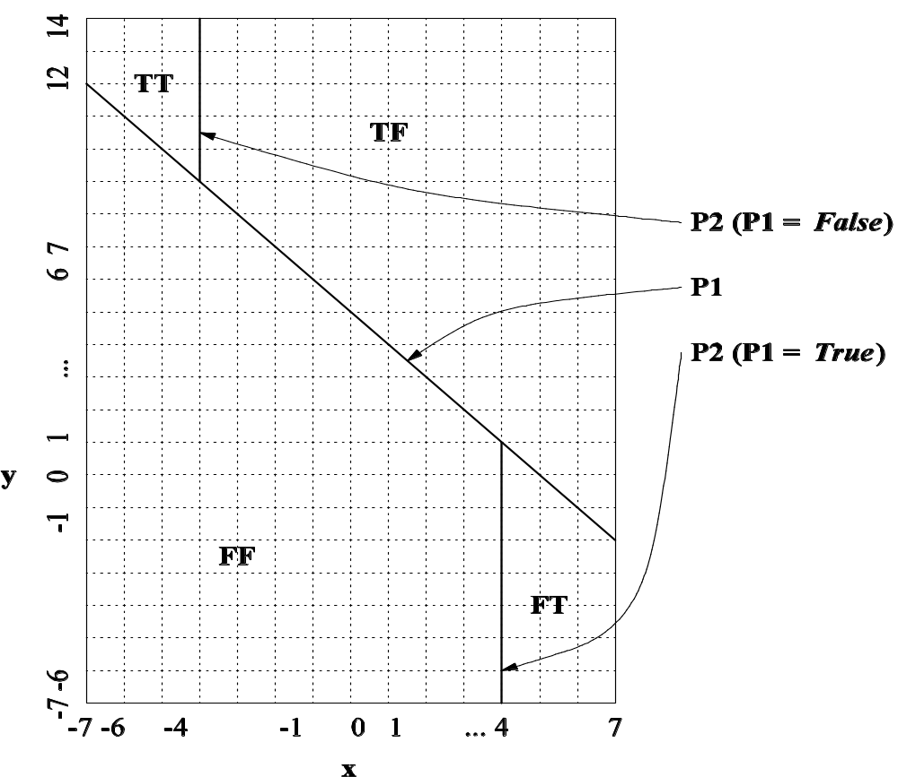
Domain Error
Figure 6.3: Control flow graph rep. of the function in Fig. 6.2.
Notes:
Handouts

Slide 11
Types of Domain Errors
Recall that
  A domain is a set of values for which the program performs identical computations.
  A domain can be represented by a set of predicates. Individual elements of a domain satisfy the corresponding predicates.
From a geometrical perspective, a domain is defined by a set of constraints, called boundary inequalities.
The properties of a domain are discussed in terms of the properties of its boundaries.
  Closed boundary
  Open boundary
  Closed domain
  Open domain
  Extreme point
  Adjacent domain
Notes:
Handouts

Slide 12
Types of Domain Errors
Closed boundary
  A boundary is said to be closed if the points on the boundary are included in the domain of interest.
    Example: Consider the TT domain in Fig. 6.4 and the boundary defined by the inequality P2: x ≤ -4. This is a closed boundary of domain TT.
Open boundary
  A boundary is said to be open if the points of the boundary do not belong to the domain of interest.
    Example: Consider the domain TT in Fig. 6.4 and its boundary defined by the inequality P1: x + y > 5. This is an open boundary of the domain TT.
Closed domain
  A domain is said to be closed if all of its boundaries are closed.
Open domain
  A domain is said to be open if some of its boundaries are open.
Notes:
Handouts

Slide 13
Types of Domain Errors
Extreme point
  An extreme point is a point where two or more boundaries cross.
Adjacent domains
  Two domains are said to be adjacent if they have a boundary inequality in common.
Notes:
Handouts

Slide 14
Types of Domain Errors
Note
  A program path will have a domain error if there is incorrect formulation of a path predicate.
  An incorrect predicate expression causes a boundary segment to
    be shifted from its correct position, or
    have an incorrect relational operator
A domain error can be caused by
  An incorrectly specified predicate, or
  An incorrect assignment which affects a variable used in the predicate.
We focus on the following kinds of boundary errors.
  Closure error
  Shifted-boundary error
  Tilted-boundary error
Notes:
Handouts

Slide 15
Types of Domain Errors
Closure error
  A closure error occurs if a boundary is open when the intention is to have a closed boundary, or vice versa.
  Example: The relational operator ≤ is implemented as <.
Shifted-boundary error
  A shifted boundary error occurs when the implemented boundary is parallel to the intended boundary.
  Example: Let the intended boundary be x + y > 4, whereas the actual boundary is x + y > 5.
Tilted-boundary error
  A tilted-boundary error occurs if the constant coefficients of the variables in a predicate defining a boundary take up wrong values.
  Example: Let the intended boundary be x + 0.5*y > 5, whereas the actual boundary is x + y > 5.
Notes:
Handouts

Slide 16
ON and OFF Points
Idea
  Data points on or near a boundary are most sensitive to domain errors.
  Sensitive means a data point falling in the wrong domain.
  The objective is to identify the data points most sensitive to domain errors so that errors can be detected by examining the program with those input values.
  Based on the above idea, we define two kinds of data points: ON and OFF.
ON point
  It is a point on the boundary or very close to the boundary.
    If a point can be chosen to lie exactly on the boundary, then choose it. This requires the boundary inequality to have an exact solution.
    If an inequality leads to an approximate solution, choose a point very close to the boundary.
OFF point
Notes:
Handouts

Slide 17
ON and OFF Points
ON point
  It is a point on the boundary or very close to the boundary.
    If a point can be chosen to lie exactly on the boundary, then choose it. This requires the boundary inequality to have an exact solution.
    If an inequality leads to an approximate solution, choose a point very close to the boundary.
  Example: Consider the boundary x + 7*y ≥ 6.
    For x = -1, the predicate gives us an exact solution of y = 1. Therefore the point (-1, 1) lies on the boundary.
    For x = 0, the predicate leads us to an approximate solution y = 0.8571428… . Since y does not have an exact solution, we can truncate it to 0.857 or round it off to 0.858. Notice that (0, 0.857) does not satisfy the predicate, whereas (0, 0.858) does satisfy. Thus, (0, 0.858) is an ON point which lies very close to the boundary. And, the on point lies outside the domain.
Notes:
Handouts

Slide 18
ON and OFF Points
OFF point
  An OFF point of a boundary lies away from the boundary.
  While choosing an OFF point, we must consider whether the boundary is open or closed w.r.t. the domain of interest.
    Open: An OFF point of the boundary is an interior point inside the domain within an ε-distance from the boundary. (ε ≡ small)
    Closed: An OFF point of that boundary is an exterior point outside the boundary with an ε-distance.
  Example (Closed): Consider a domain D1 with a boundary x + 7*y ≥ 6. An OFF point lies outside the domain. (-1, 0.99) lies outside D1.
  Example (Open): Consider a domain D2 that is adjacent to D1 above with an open boundary x + 7*y < 6. (-1, 0.99) lies inside D2.
Notes:
Handouts

Slide 19
ON and OFF Points
Summary of ON and OFF points
  For a closed boundary: an ON point lies within the domain of interest, whereas an OFF point lies in an adjacent domain.
  For an open boundary, an ON point lies in an adjacent domain, whereas an OFF point lies within the domain of interest.
Notes:
Handouts

Slide 20
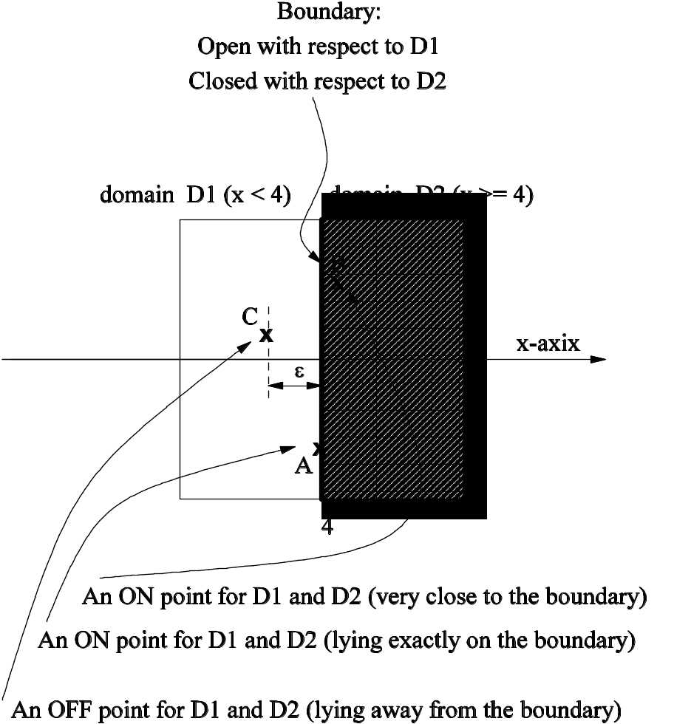
ON and OFF Points
Figure 6.6: ON and OFF points.
Notes:
Handouts

Slide 21
Test Selection Criterion
Selection criterion: For each domain and for each boundary
  select three points A, C, and B in an ON-OFF-ON sequence.
We will consider the following kinds of errors.
  Closed inequality boundary
    1.a Boundary shift resulting in a reduced domain
    1.b Boundary shift resulting in an enlarged domain
    1.c Boundary tilt
    1.d Closure error
  Open inequality boundary
    2.a Boundary shift resulting in a reduced domain
    2.b Boundary shift resulting in an enlarged domain
    2.c Boundary tilt
    2.d Closure error
  Equality boundary
Notes:
Handouts

Slide 22
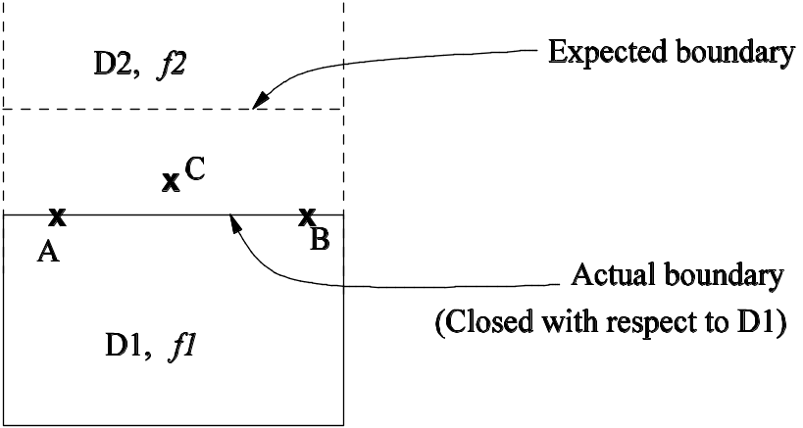
Test Selection Criterion
Closed inequality boundary
  1.a Boundary shift resulting in a reduced domain
Figure 6.7: Boundary shift resulting in a reduced domain (closed inequality).
Test data | Actual output | Expected output | Fault detected
A | f1(A) | f1(A) | No
B | f1(B) | f1(B) | No
C | f2(C) | f1(C) | Yes
Table 6.2: Detection of boundary shift resulting in a reduced domain (closed inequality).
Notes:
Handouts

Slide 23
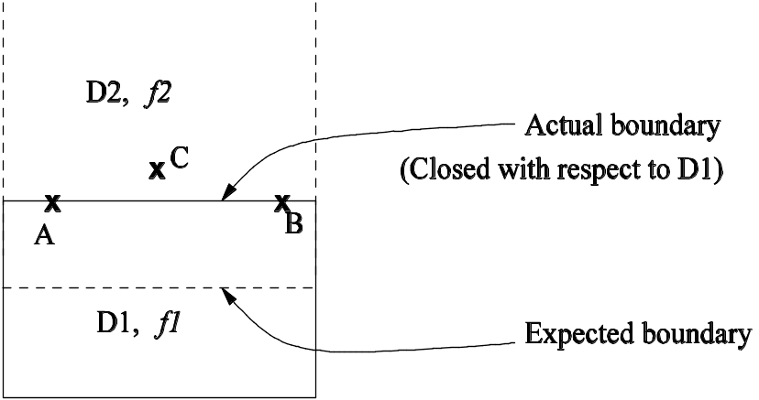
Test Selection Criterion
Closed inequality boundary
  1.b Boundary shift resulting in an enlarged domain
Figure 6.8: Boundary shift resulting in an enlarged domain (closed inequality).
Test data | Actual output | Expected output | Fault detected
A | f1(A) | f2(A) | Yes
B | f1(B) | f2(B) | Yes
C | f2(C) | f2(C) | No
Table 6.3: Detection of boundary shift resulting in an enlarged domain (closed inequality).
Notes:
Handouts

Slide 24
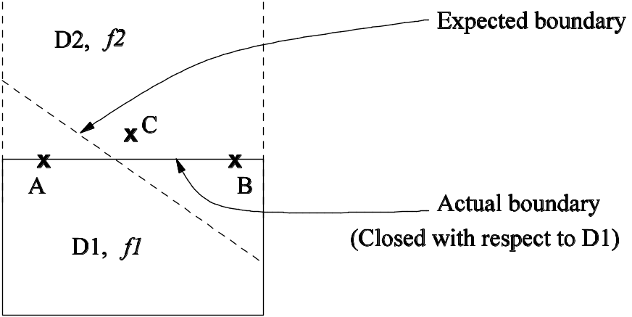
Test Selection Criterion
Closed inequality boundary
  1.c Tilted boundary
Figure 6.9: Tilted boundary (closed inequality).
Test data | Actual output | Expected output | Fault detected
A | f1(A) | f1(A) | No
B | f1(B) | f2(B) | Yes
C | f2(C) | f2(C) | No
Table 6.4: Detection of tilted boundary (closed inequality).
Notes:
Handouts

Slide 25
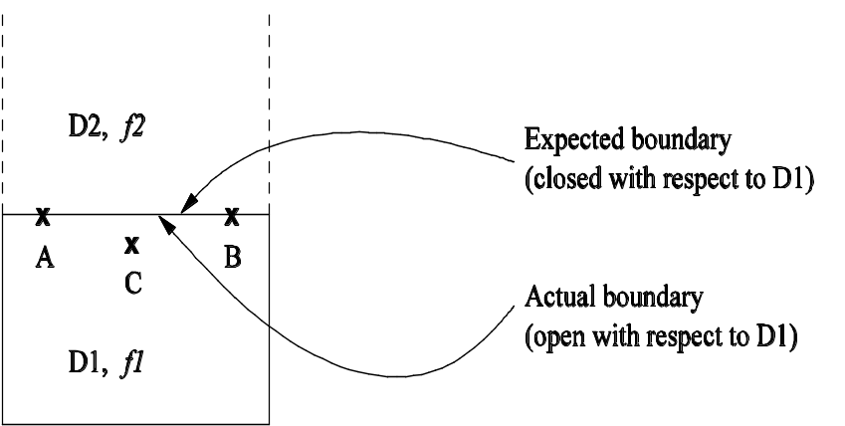
Test Selection Criterion
Closed inequality boundary
  1.d Closure error
Figure 6.10: Closure error (closed inequality).
Test data | Actual output | Expected output | Fault detected
A | f2(A) | f1(A) | Yes
B | f2(B) | f1(B) | Yes
C | f1(C) | f1(C) | No
Table 6.5: Detection of closure error
(closed inequality).
Notes:
Handouts

Slide 26
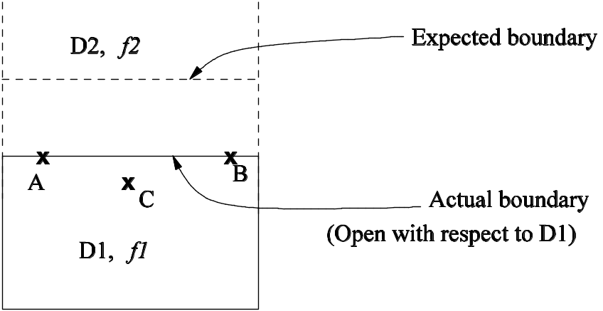
Test Selection Criterion
Open inequality boundary
  2.a Boundary shift resulting in a reduced domain
Figure 6.11: Boundary shift resulting in a reduced domain (open inequality).
Test data | Actual output | Expected output | Fault detected
A | f2(A) | f1(A) | Yes
B | f2(B) | f1(B) | Yes
C | f1(C) | f1(C) | No
Table 6.6: Detection of boundary shift resulting in a reduced domain (open inequality).
Notes:
Handouts

Slide 27
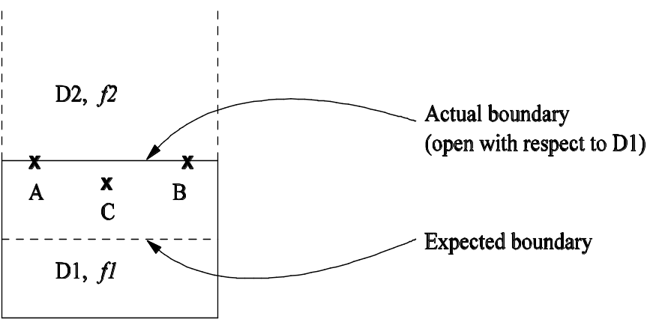
Test Selection Criterion
Open inequality boundary
  2.b Boundary shift resulting in an enlarged domain
Figure 6.12: Boundary shift resulting in an enlarged domain (open inequality).
Test data | Actual output | Expected output | Fault detected
A | f2(A) | f2(A) | No
B | f2(B) | f2(B) | No
C | f1(C) | f2(C) | Yes
Table 6.7: Detection of boundary shift resulting in an enlarged domain (open inequality).
Notes:
Handouts

Slide 28
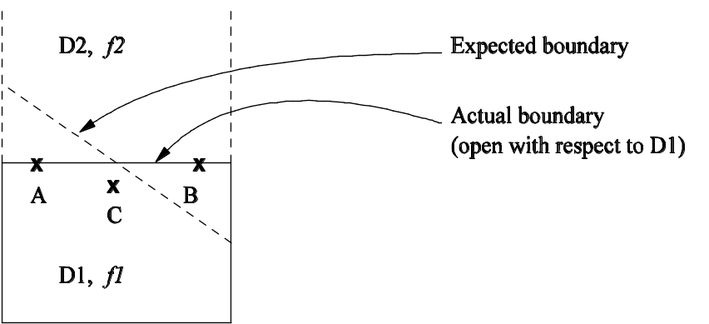
Test Selection Criterion
Open inequality boundary
  2.c Tilted boundary
Figure 6.13: Tilted boundary (open inequality).
Test data | Actual output | Expected output | Fault detected
A | f2(A) | f1(A) | Yes
B | f2(B) | f2(B) | No
C | f1(C) | f1(C) | No
Table 6.8: Detection of tilted boundary
(open inequality).
Notes:
Handouts

Slide 29
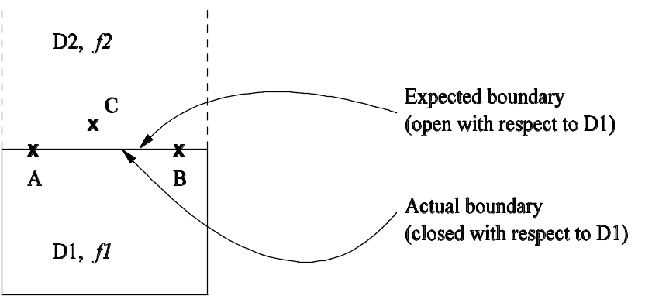
Test Selection Criterion
Open inequality boundary
  2.d Closure error
Figure 6.14: Closure error (open inequality).
Test data | Actual output | Expected output | Fault detected
A | f1(A) | f2(A) | Yes
B | f1(B) | f2(B) | Yes
C | f2(C) | f2(C) | No
Table 6.9: Detection of closure error
(open inequality).
Notes:
Handouts

Slide 30
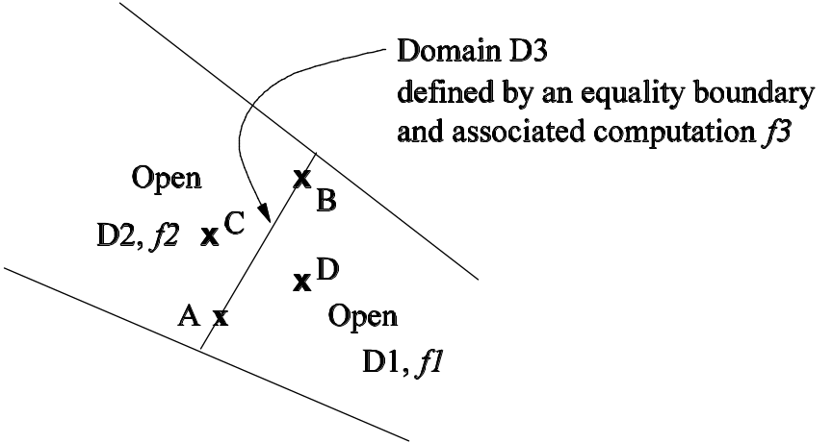
Test Selection Criterion
Equality border
Figure 6.15: Equality border
Notes:
Handouts

Slide 31
Summary
Concepts
  Two kinds of program error: computation errors and domain errors
  Domain: A set of inputs for which the program executes the same path.
  Domain error: A domain error occurs when an input value causes the program to execute the wrong path.
  A program is viewed as an input classifier. It classifies the input into a set of (sub)domains such that the program executes a different path for each domain.
  Each domain is identified by a set of boundaries, and each boundary is expressed as a boundary condition.
  Properties of boundaries: closed, open, closed domain, …
  Three kinds of boundary errors were identified.
  closure error, shifted boundary, tilted boundary
  ON and OFF points
Test selection criterion: For each domain and for each boundary, select three points A, C, and B in an ON-OFF-ON sequence.
Notes:
Handouts

